Slide 1
Remote Measurement and monitoring
Wesley Myers

Slide 2

Project Goals
Requirement Driver
Remote Measurement
Remote Viewing
Web Interface Control
Autonomy for Monitoring

Slide 3
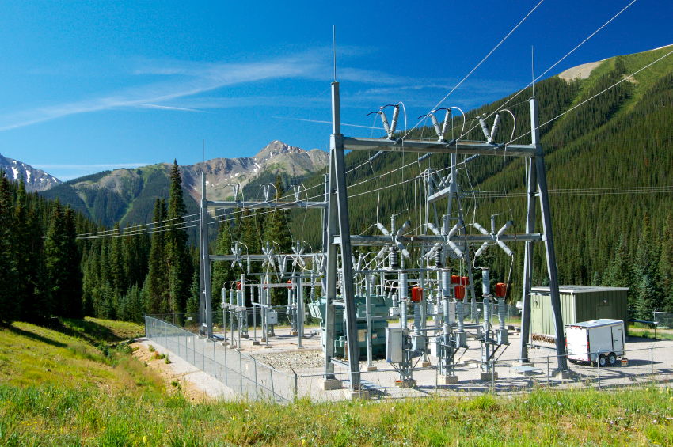
Requirements
Measure distance (+/- 1 cm) to targets out to 50 meters
View Targets with Camera
Remote/automated pan-tilt system
Wireless Control
Control through Web Interface

Slide 4
System Layout
CSI
Bus
GPIO
Range Finder
Raspberry Pi
Raspberry Pi Camera
Webserver
Pan Servo
OpenCV
Tilt Servo
USB
WiFi Dongle

Slide 5
Equipment
Item | Qty | Cost
Raspberry Pi | 1 | $40.00
Camera | 1 | $35.00
Camera (IR) | 1 | $35.00
Laser Range Finder | 1 | $500.00
Wifi Dongle | 1 | $12.00
Servos | 2 | $10.00
Other Materials |  | unknown

Slide 6
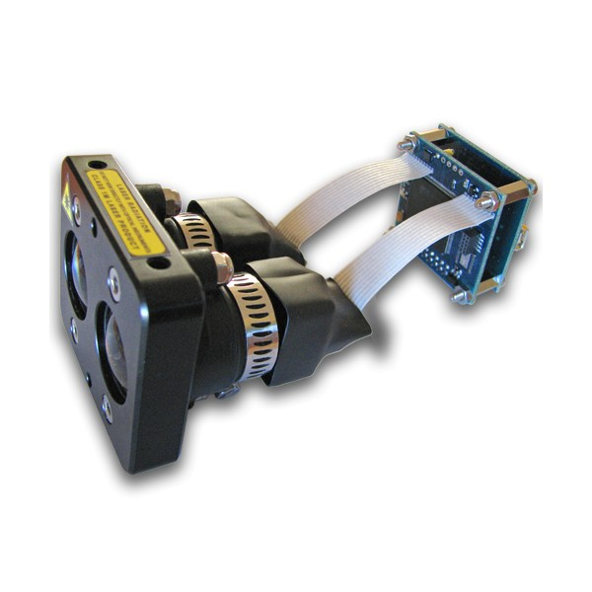
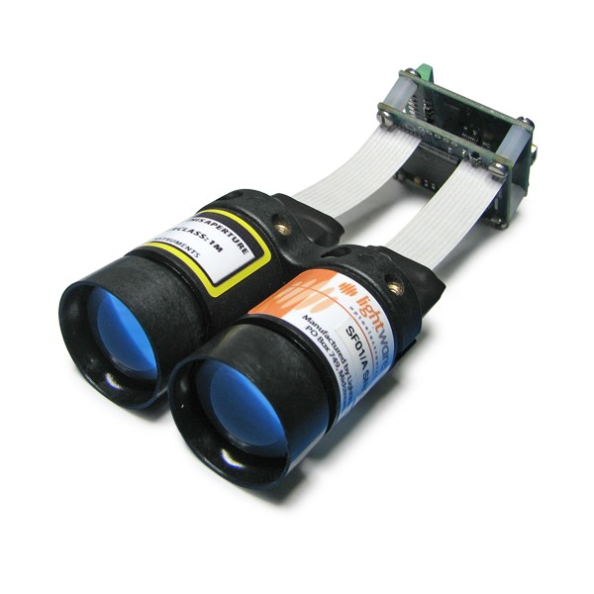
Laser Range Finder
Industrial Grade Laser Range Finders
Interface-able with Raspberry Pi
850 nm Wavelength
http://www.lightware.co.za/shop/en/lrf-modules/31-sf01a.html

Slide 7
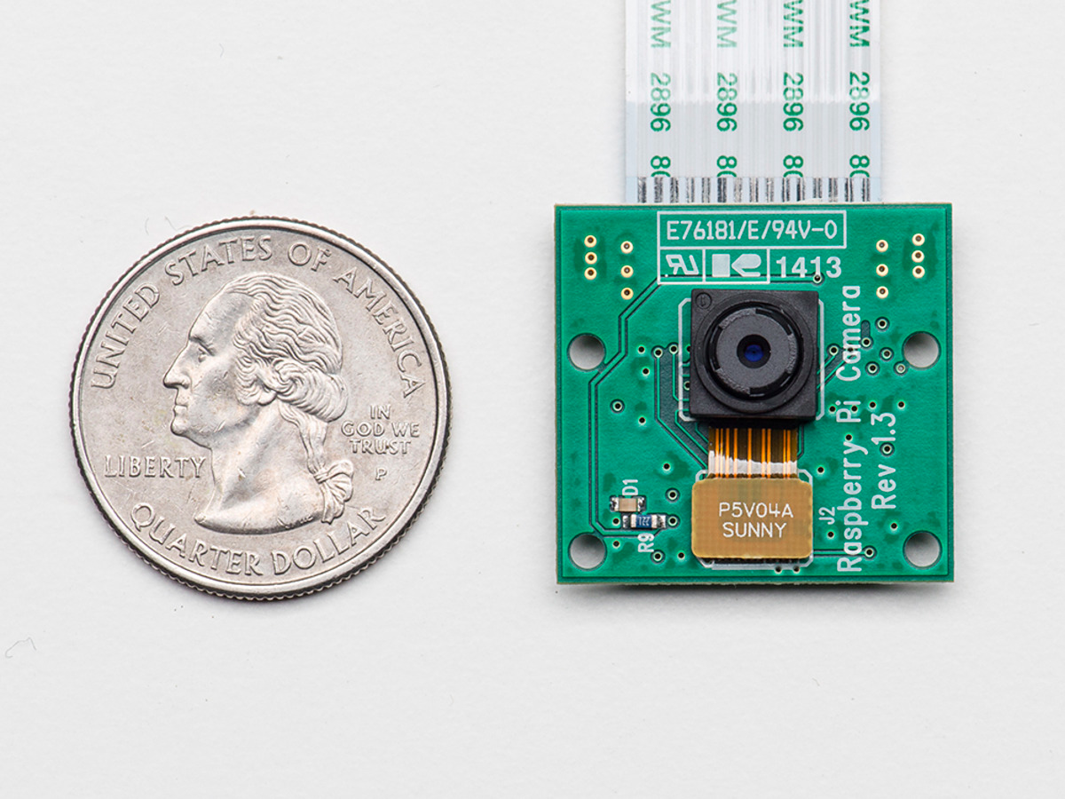

Camera / OpenCV
2592 x 1499 pixels
NoIR Camera Board
Automatic Feature Detection
Notes:
LPF
R = 1 kOhm
C = 15 micro Farads

Slide 8
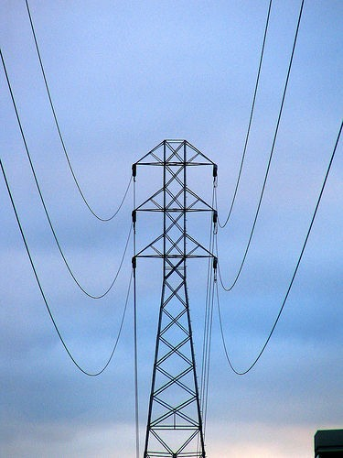
Challenges
Use of Servos
Detection of small targets
.02 m
.23 degrees
50 m

Slide 9
FSM Overview
User Selects Target to Measure within FOV
Yes
Aimed?
No
Aim Pan-Tilt Towards Target
Execute Measurement Algorithm
Display Information to User
Notes:
LPF
R = 1 kOhm
C = 15 micro Farads

Slide 10
Algorithm
TL
TR
Pan-Tilt over available area
Combination of inputs
1-degree
BL
BR
1-degree
TL-TR
TR-BR
BR-BL
BL-TL
TL-BR
BL-TR

Slide 11
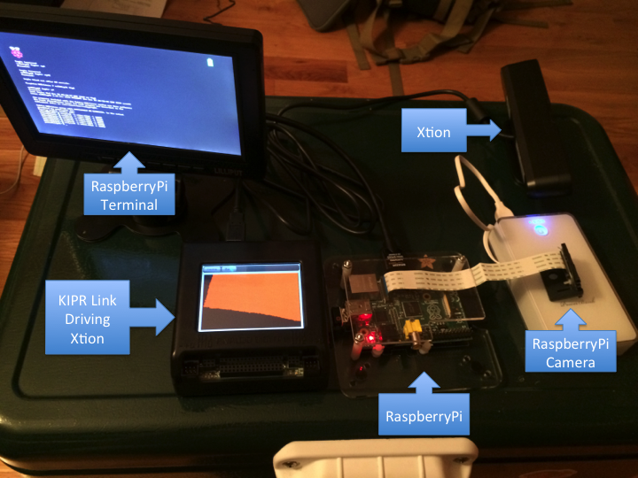
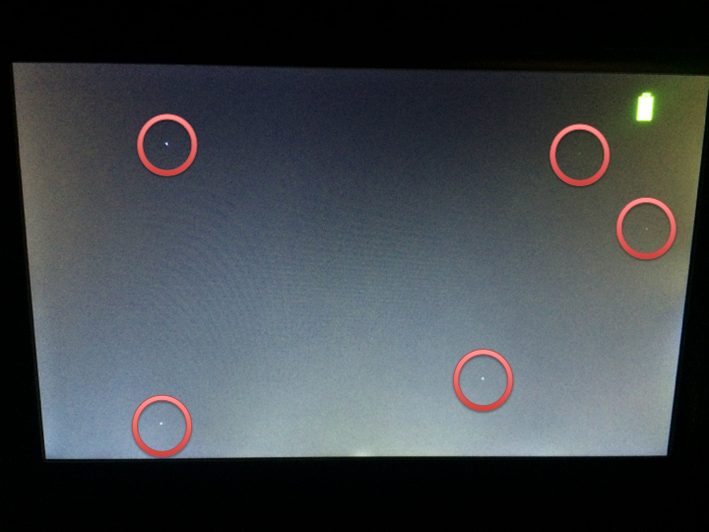
Verification Testing
Questions
Can we see the laser?
Notes
Kinect outputs 830 nm wavelength
Results
Not visible in daylight
Sporadic
Inconclusive
Future Testing
Test with IR Camera

Slide 12
Schedule
Date | Milestone
September 29th | Ordering and Receiving Equipment
October 6th | Pan Tilt Mechanism / CDR Due / TDY Tuesday – Friday
October 13th | Camera and Laser Integration
October 20th | Continue Integration / TDY Sunday - Wednesday
October 27th | OpenCV Development
November 3rd | UI and Webserver Design
November 10th | Algorithm Development
November 17th | Algorithm Development
November 24th | Testing and Analysis
December 1st | Testing and Analysis
December 8th | Project Documentation Due
December 13th | Final Presentation

Slide 13
Reach Goals
Addition of Security Camera Features
Automatic Motion Detection
Email/Text Alert
Saving imagery to Dropbox

Slide 14
Questions?

